Slide 1
Conquest and Settlement, 782–1086 Sarah Greer (St Andrews) & Alice Hicklin (Berlin)

Slide 2
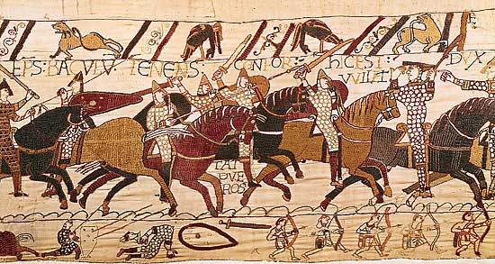
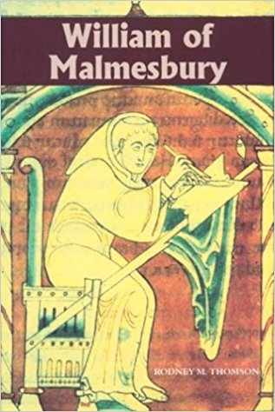
The courageous leaders mutually prepared for battle, each according to his national custom. The English passed the night without sleep, in drinking and singing.…On the other hand, the Normans passed the whole night in confessing their sins, and received the communion of the Lord‘s body in the morning”
“Drinking in parties was a universal practice, in which occupation they passed entire nights as well as days. They consumed their whole substance in mean and despicable houses, unlike the Normans and French, who live frugally in noble and splendid mansions. The vices attendant on drunkenness, which enervate the human mind, followed; hence it came about that when they engaged William, they doomed themselves and their country to slavery by a single, and that an easy, victory

Slide 4
Timeline of Viking raids
789: First recorded Viking attack in Dorset
793: Vikings attack monastery of Lindisfarne, Northumbria
795: Vikings attack monastery of Iona, Scotland
792-822: Diplomas show Viking activity and camps in Kent
844: Large Anglo-Saxon defeat recorded in Frankish chronicle – the Vikings ‘wielded power over land at will’.
851: Large Viking defeat recorded in Anglo-Saxon Chronicle and Frankish chronicle.
851: Vikings stay in Kent over winter.

Slide 5
The ‘Great Army’
865/6: arrives in East Anglia.
867: seizes York, subjugates kingdom of Northumbria.
869: subjugates kingdom of East Anglia, martyrdom of King Edmund.
871: ‘Summer Army’ arrives and joins up with Great Army.
873: subjugates kingdom of Mercia.
Early 878: Wessex loosely under Viking control.
Mid 878: Alfred wins victory over Guthrum at Edington.
Late 878: part of fleet leaves to campaign in Frankish kingdoms.

Slide 6
Alfred and Guthrum
Victory at Edington for Alfred in mid-878.
Guthrum and followers are baptised.
Both agree to a peace treaty.
Foundation of the Danelaw?

Slide 7
Viking Settlement
Areas of northern and eastern England under Viking control for almost a century.
Difficult to see boundaries within the Danelaw – constantly shifting in response to Wessex raids.
Problems with sources – Vikings cast as pagans fighting against Christian Anglo-Saxons.

Slide 8
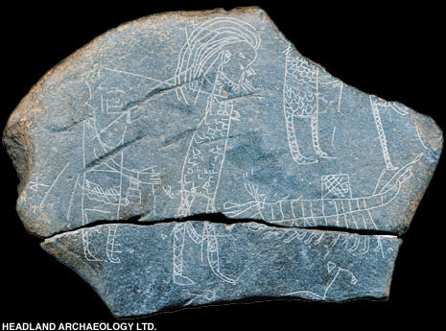
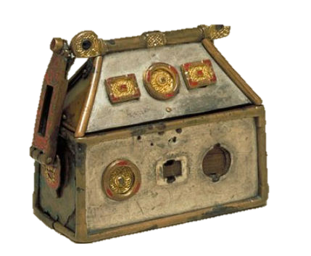
Inchmarnock Hostage Stone

Slide 9
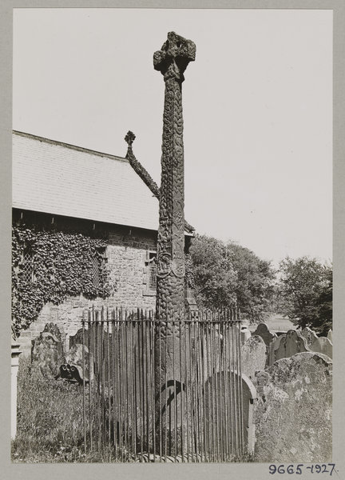
The Gosforth Cross
Images: © Victoria and Albert Museum, London https://www.visitcumbria.com/wc/gosforth-st-marys-church/#gallery/3bc66fb20b2d4133dd336722a10f366d/2294
http://viking.archeurope.info/index.php?page=the-gosforth-cross

Slide 11
The Conquest of Swein Forkbeard

Slide 12
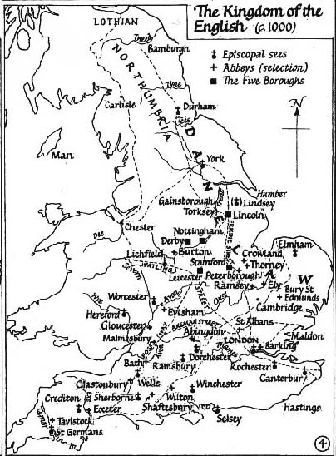
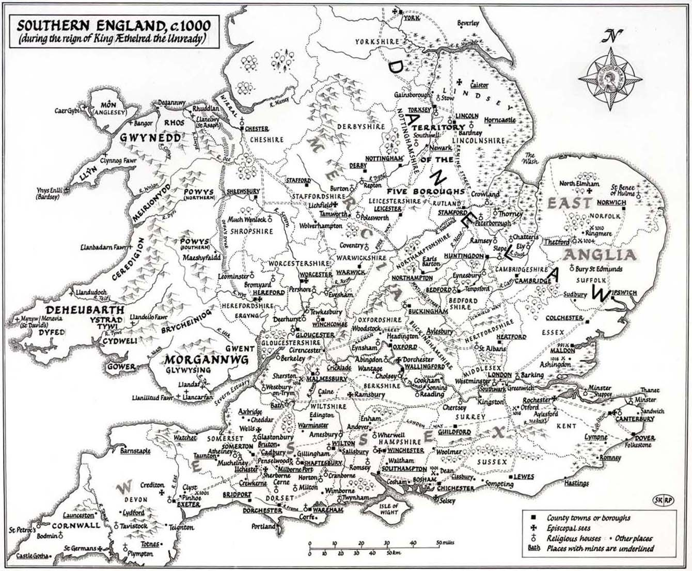

Slide 14
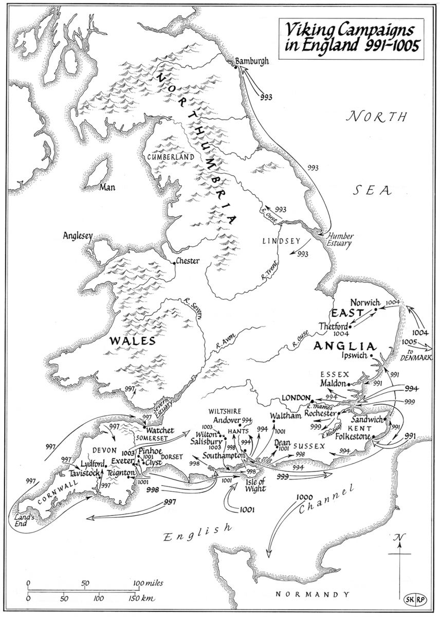

Slide 15
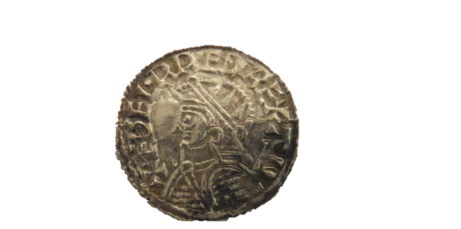
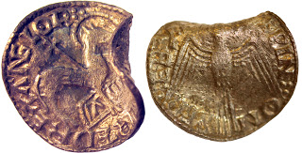
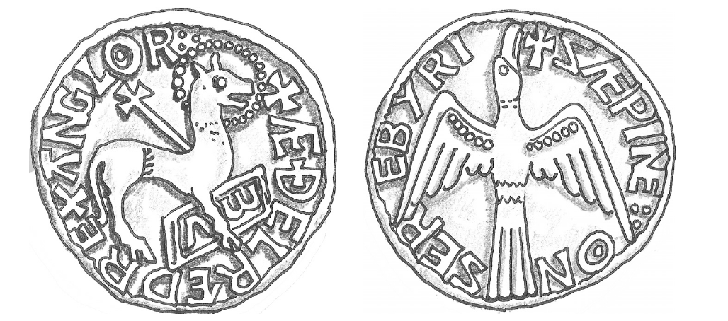
Helmet type of Æthelred II,
minted by Eadric at
Thetford, 1003x9
Agnus Dei type of Æthelred II,
minted by Eadric at
Thetford, 1012

Slide 17
Cnut

Slide 18
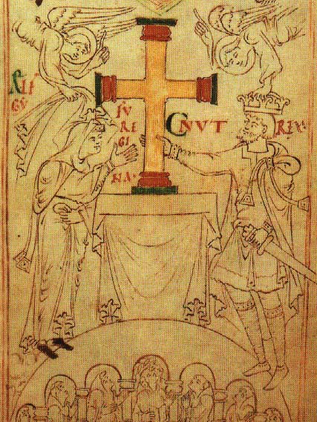
Cnut

Slide 19
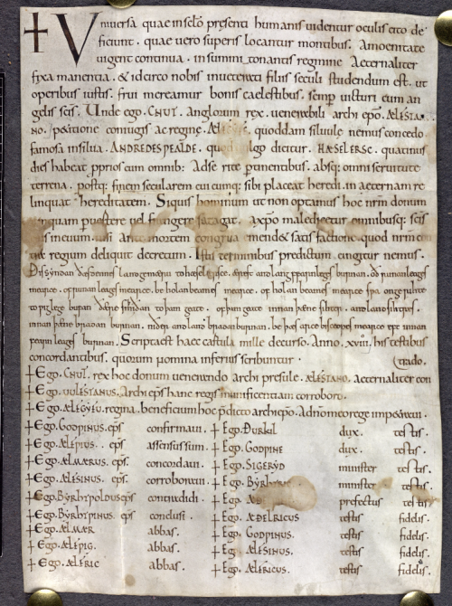
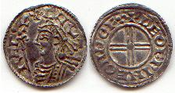
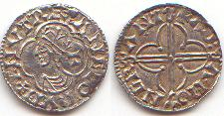
Cnut gives woodland to Ælfstan Lyfing, archbishop of Canterbury, at the request of Queen Emma (Ælfgifu), England (Eadwig Basan, scribe of Christ Church, Canterbury), Stowe Charter 38.

Slide 21
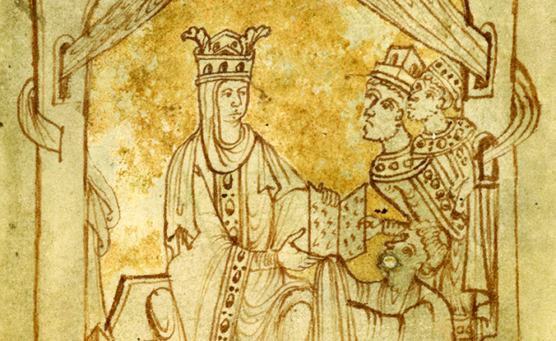
Queen Emma, wife of Æthelred II and Cnut, receives the book she commissioned from its author, watched by her sons Harthacnut and Edward the Confessor. Copyright British Library Board.

Slide 22
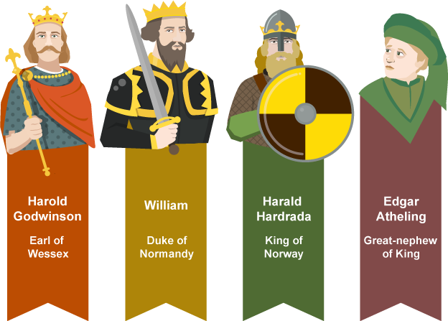

Slide 23
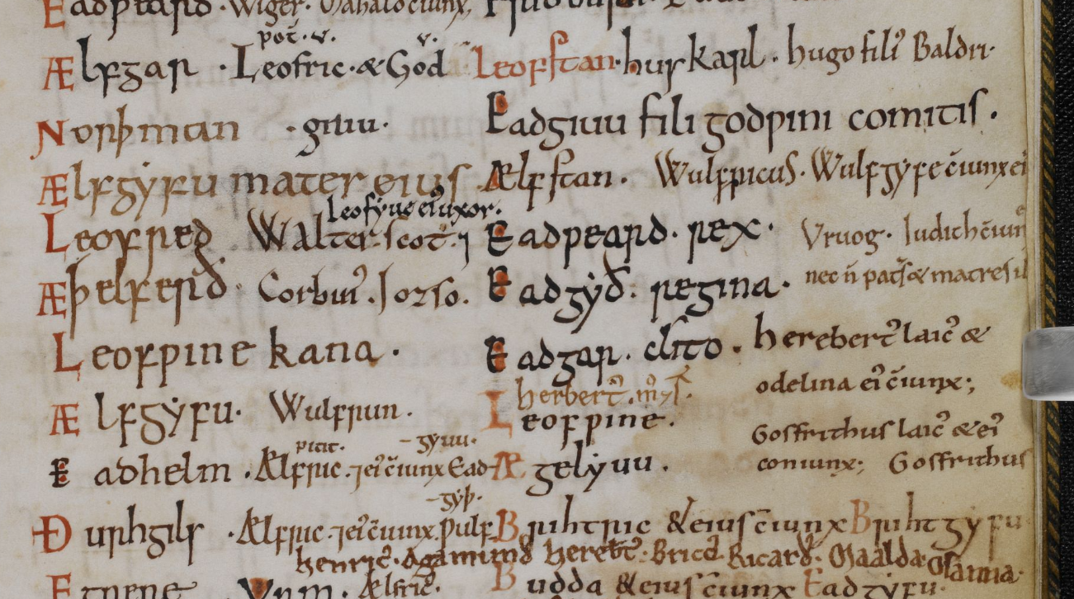

Slide 24
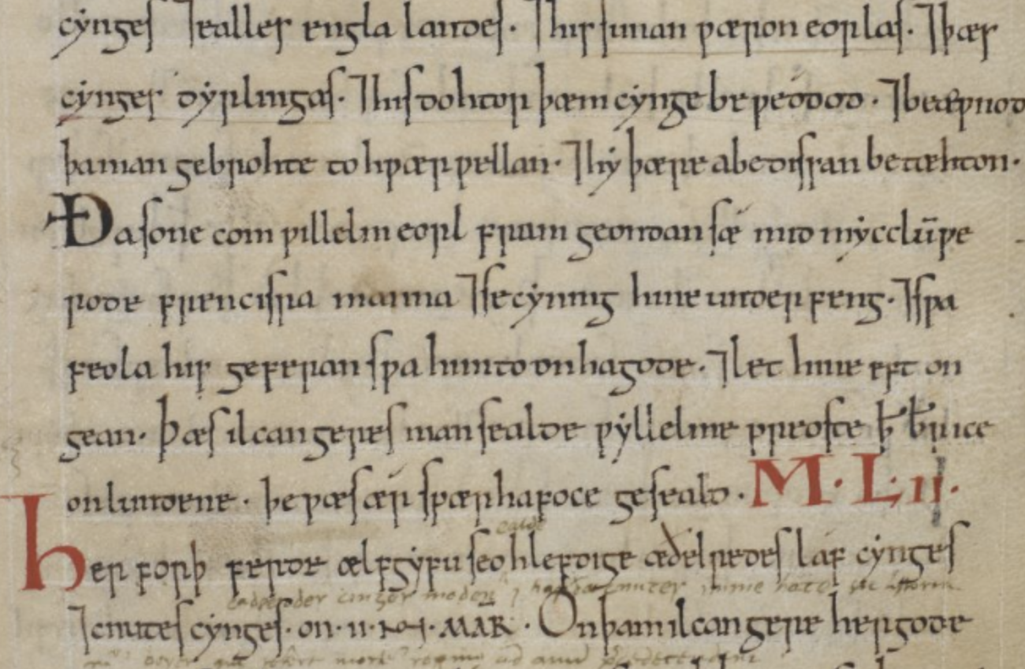
Anglo-Saxon Chronicle D Text. Briish Library Cotton Tiberius B IV 74 r

Slide 25
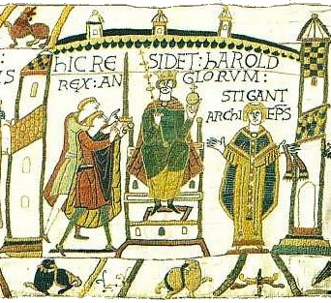

Slide 26
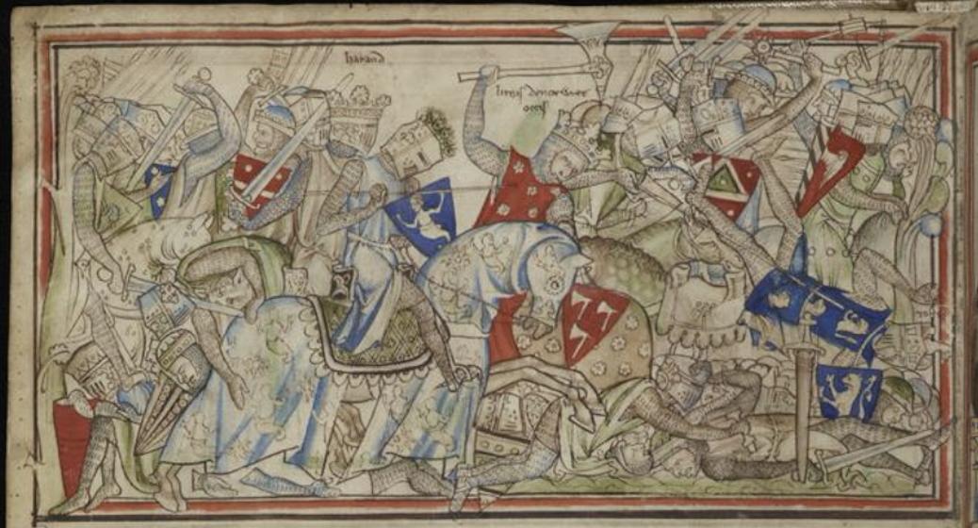

Slide 27
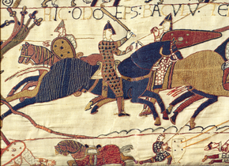

Slide 28
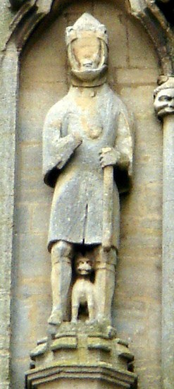
William crossed the cold channel and reddened the bright swords, and now he has betrayed noble Earl Waltheof. It is true that killing in England will be a long time ending. A braver lord than Waltheof will never be seen on earth.

Slide 29
William’s castles 1066–87
Chepstow
Established by the Conqueror’s friend William fitz Osbern soon after 1066, Chepstow was acquired by the king in 1075.
Pevensey
William built his first castle in England here, the point of the Normans’ disembarkation, to protect his army while they prepared to engage Harold Godwinson.
Dover
After Hastings, William reportedly spent eight days at Dover, and afterwards entrusted it tohis half-brother Odo of Bayeux.
London
This was established shortly before Christmas 1066. Work on the White Tower started in the 1070s and continued until the early 12th century.
Old Sarum
Old Sarum was probably begun before 1070.
Windsor
This most famous of English castles was created probably before the council held at Windsor in 1070.
Durham
On his return from Scotland in 1072, William stopped to plant a castle in Durham where, three years earlier, his troops had been massacred by the Northumbrians.
York
William built not one but two castles in York: the first (Clifford’s Tower) was constructed in the summer of 1068, the second (Baile Hill) early the following year.
Norwich
Norwich was begun before 1075.
Colchester
A gigantic building, with close affinities to the Tower of London.

